Slide 1


Title: Universal Declaration of Human Rights (UDHR) Subtitle: Overview, Core Principles, Impact, and Global Relevance Your Name: Bayzid Bustami Date:
University of Barishal

Slide 2
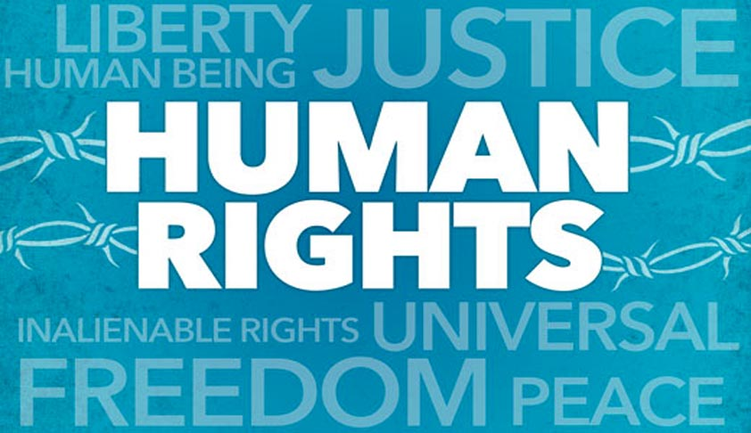
Introduction to the UDHR
Content:
Adopted on: December 10, 1948, by the United Nations General Assembly.
Purpose: To establish a common standard for the protection of human rights worldwide.
Key Principle: The UDHR proclaims fundamental human rights to be universally protected.
Inspiration: It was the result of the atrocities of World War II and a commitment to ensuring "never again" would such violations occur.
Visuals:
Include an image of the UDHR document or the UN emblem.

Slide 3

Core Principles of the UDHR
Content:
Equality and Dignity:
All humans are born free and equal in dignity and rights.
Every individual is entitled to their rights without distinction of race, sex, language, or religion.
Universal Rights:
The UDHR applies to every human being, regardless of nationality, ethnicity, or background.
Freedom and Justice:
Includes rights such as the right to life, liberty, and security of person.
Ensures freedom of expression, freedom of thought, and the right to participate in government.
Visuals:
Use icons representing equality, freedom, and justice.

Slide 4
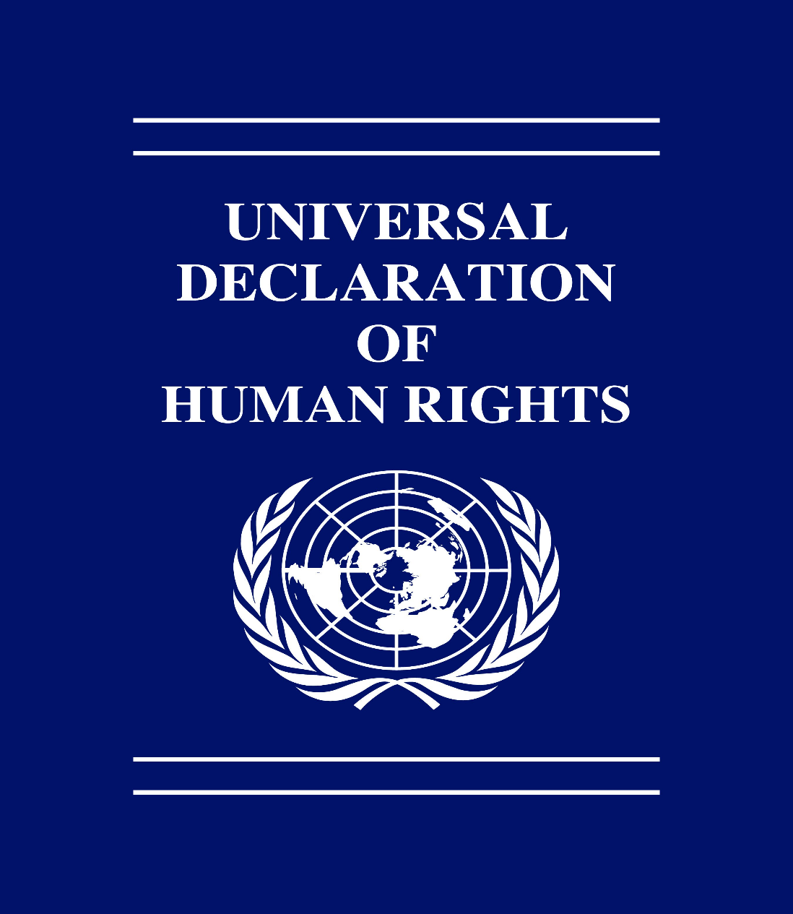
Key Articles of the UDHR
Content:
Article 1: "All human beings are born free and equal in dignity and rights."
Article 3: "Everyone has the right to life, liberty, and security of person."
Article 21: "Everyone has the right to participate in government and in free elections."
Visuals:
Highlight the text of these articles (use a clean, readable font).
Include related icons such as a peace dove for Article 3 or a ballot box for Article 21.

Slide 5
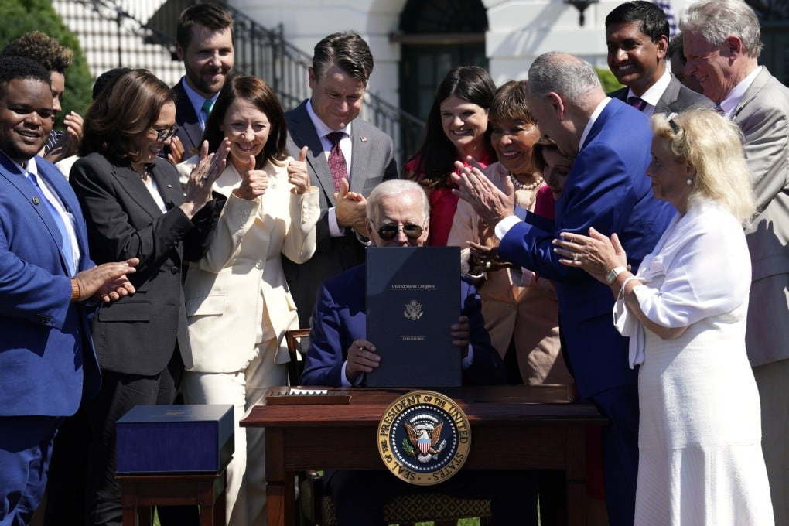
Slide 5: Global Impact and Legacy
Content:
The UDHR has influenced the creation of international treaties like:
International Covenant on Civil and Political Rights (ICCPR).
International Covenant on Economic, Social, and Cultural Rights (ICESCR).
Inspiration for National Laws: Many countries have incorporated UDHR principles into their own constitutions and legal systems.
Continued Relevance: The UDHR remains a critical reference for human rights advocacy, policy development, and international human rights organizations.
Visuals:
Include icons or images representing international treaties, justice scales, and global human rights organizations.

Slide 6
Conclusion

